Slide 1
Tangle Tabulation
Zachary Bryhtan^{*1}, Isabel Darcy¹, Joe Starr¹, Ethan Rooke¹, Nicholas Connolly
¹University of Iowa

Slide 2
Introduction

Slide 3
Knot and Link Tabulation
Lord Kelvin
P. G. Tait
C. N. Little
M. Dehn
J. Alexander
K. Reidemeister
H. Seifert
J. H. Conway

Slide 4
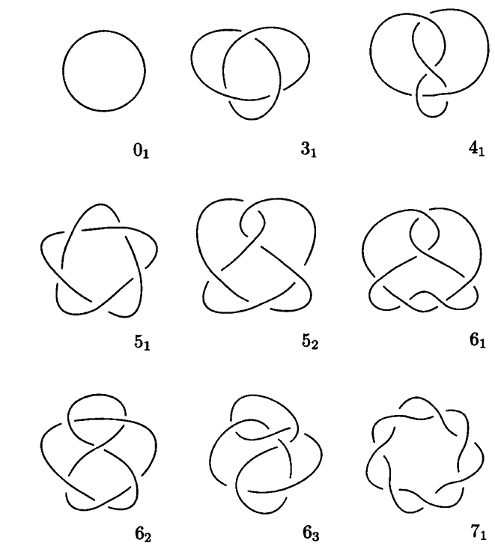
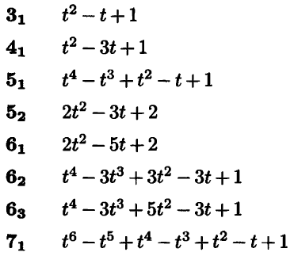
Knot and Link Tabulation
Alexander Polynomial

Slide 5
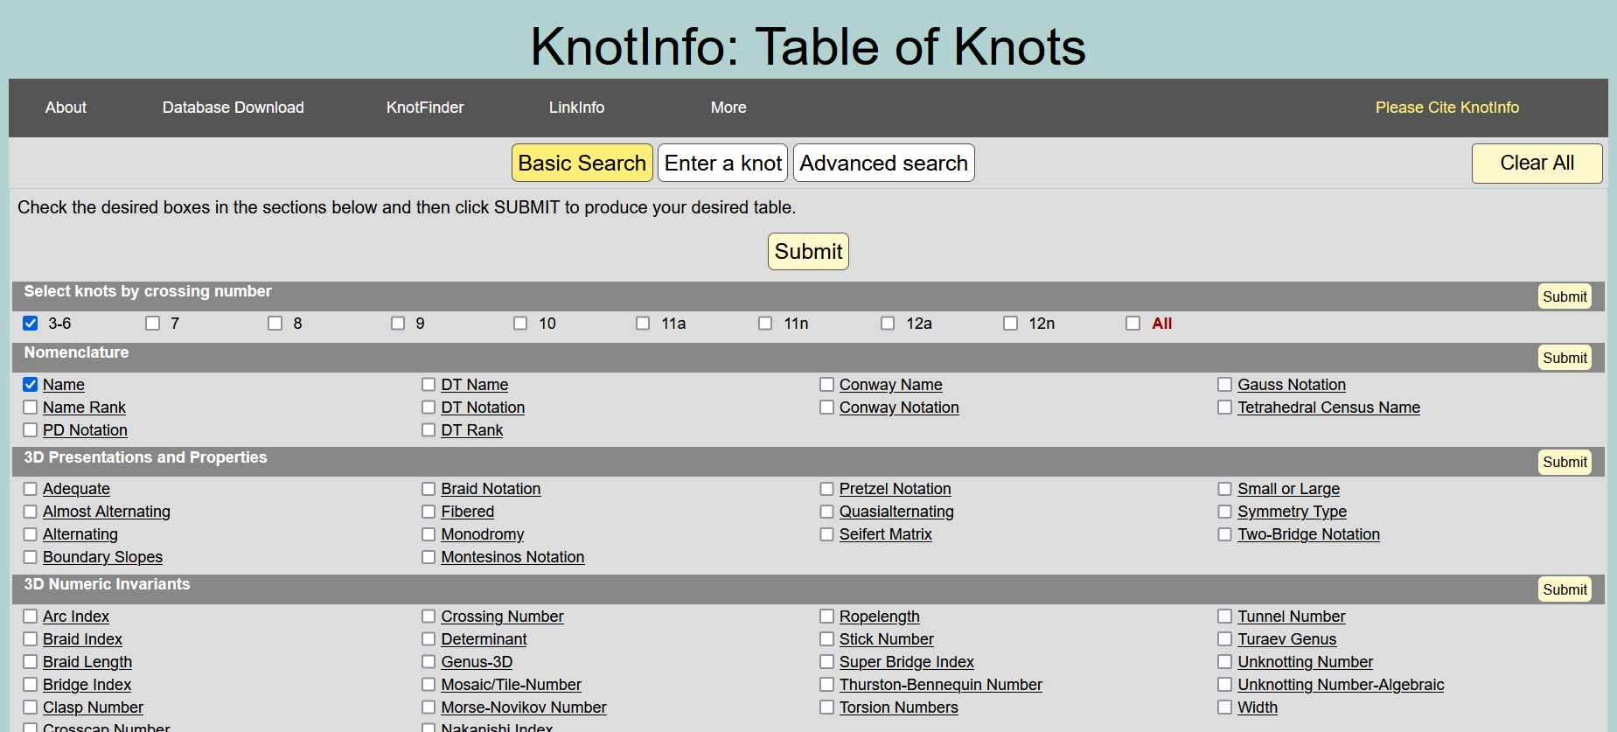
Knot and Link Tabulation
https://knotinfo.math.indiana.edu/

Slide 6
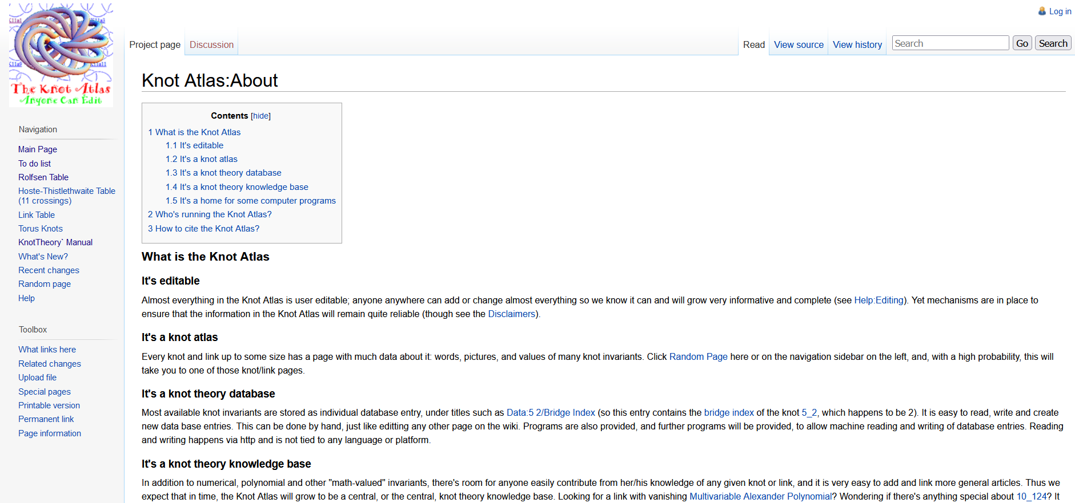
Knot and Link Tabulation
http://katlas.org/wiki/Knot_Atlas:About

Slide 7
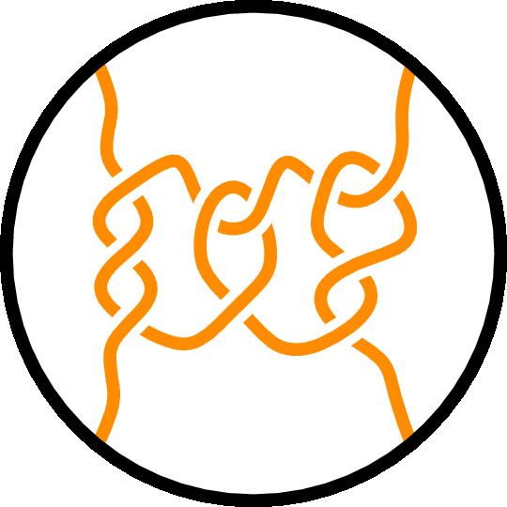
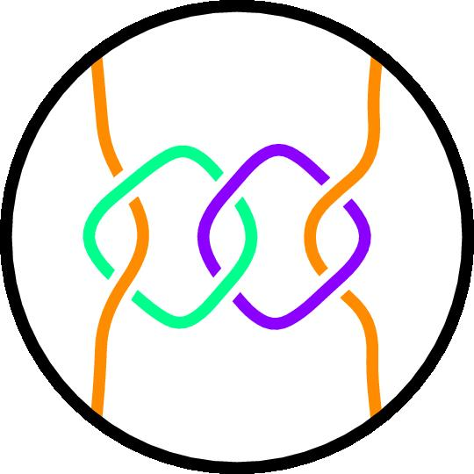
2-String Tangles
Definition. A 2-tangle is a ball containing 2 disjoint properly embedded arcs with endpoints fixed on the boundary of the ball along with a possibly non-empty set of interior loops.

Slide 8

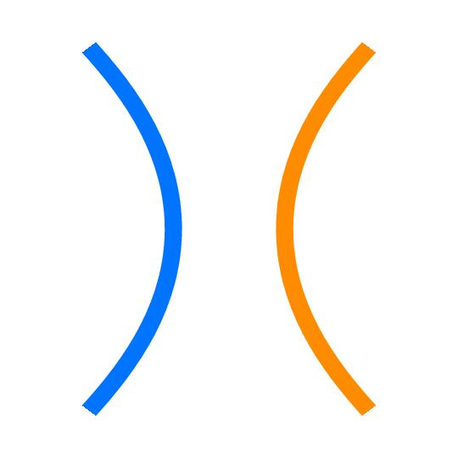
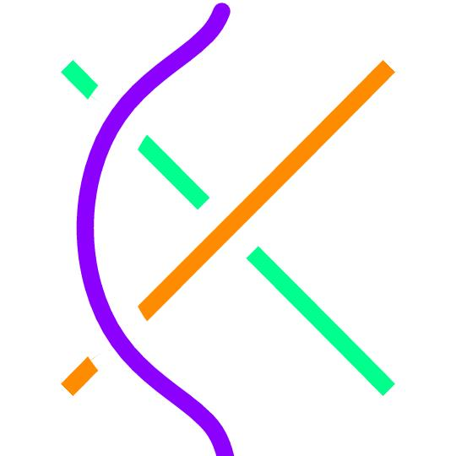


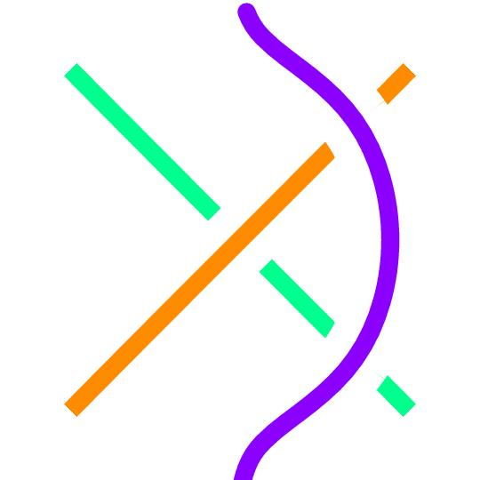
2-String Tangles
Definition. Any two 2-tangles are equivalent if one can be made from the other using Reidemeister moves.

Slide 9
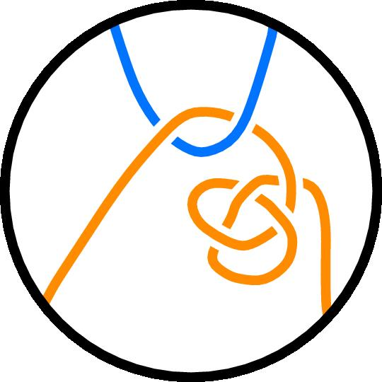
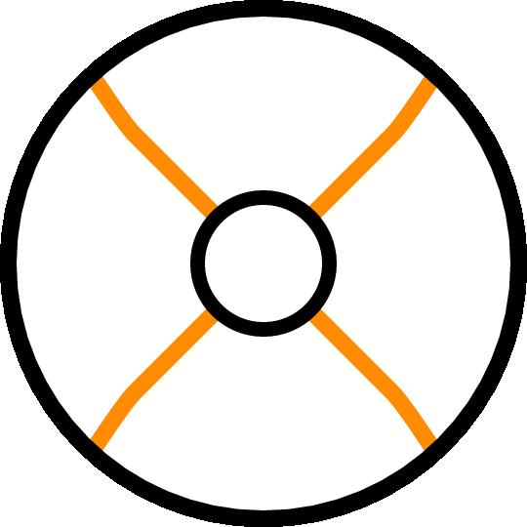
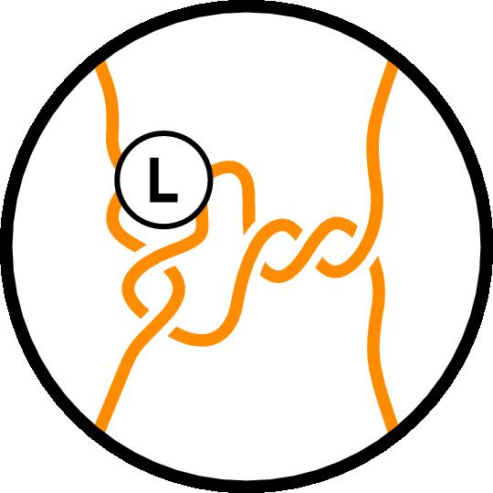
2-String Tangles
L
Consider both free and fixed endpoints
No local knots

Slide 10

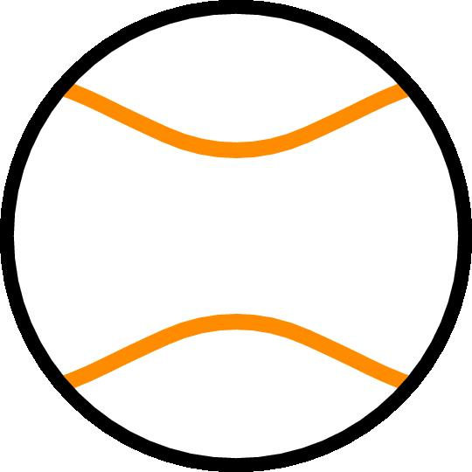

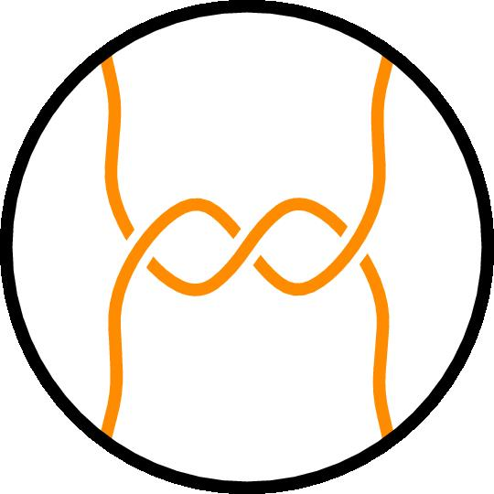
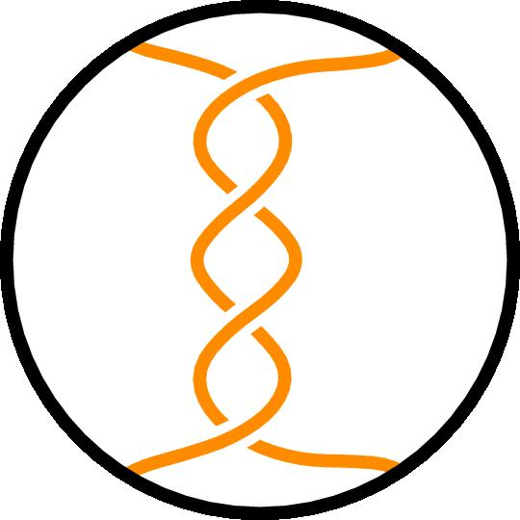
2-String Tangles

Slide 11






2-String Tangles
$$−1$$
$$0$$
$$+1$$
$$∞$$
$$\frac{3}{1}$$
$$\frac{1}{4}$$

Slide 12
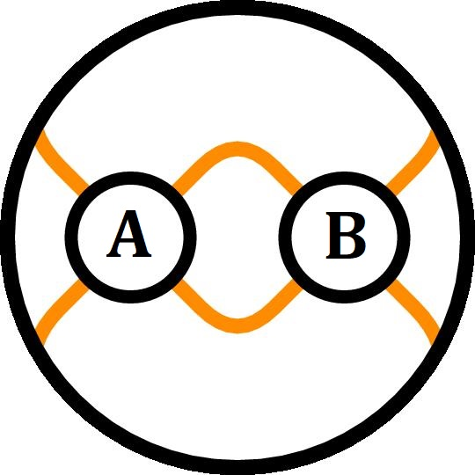
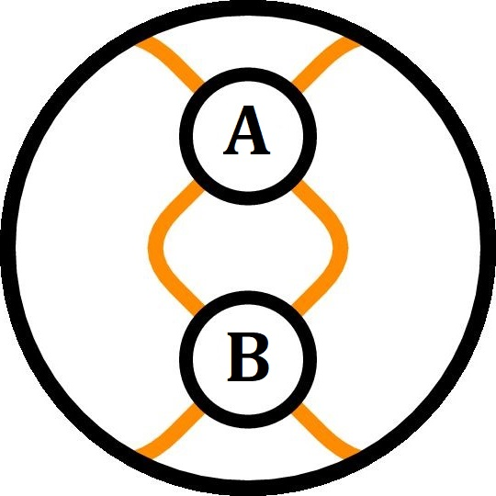
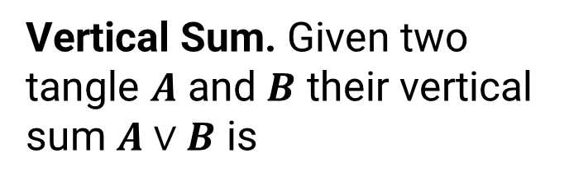
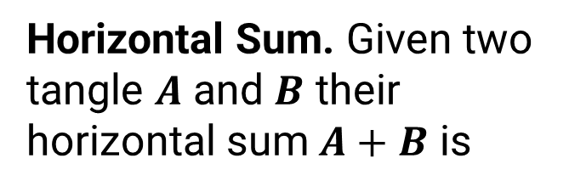
2-String Tangles
Horizontal Sum. Given two tangle $A$ and $B$ their horizontal sum $A+B$ is
Vertical Sum. Given two tangle $A$ and $B$ their vertical sum $A∨B$ is

Slide 13
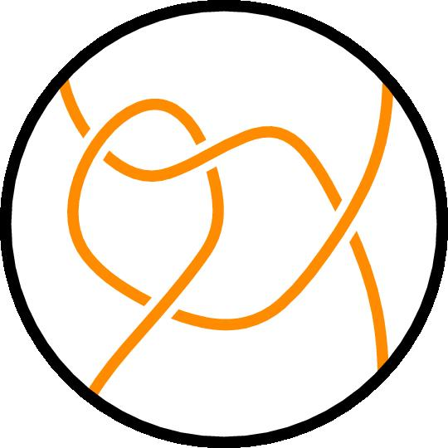
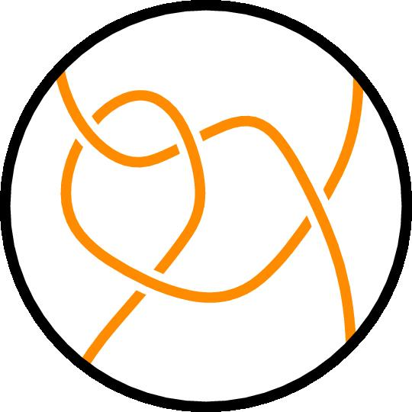

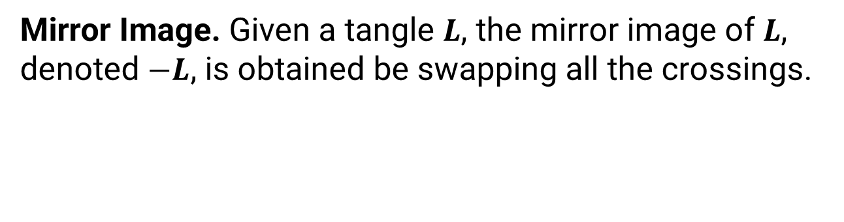

2-String Tangles
Mirror Image. Given a tangle $L$, the mirror image of $L$, denoted $−L$, is obtained be swapping all the crossings.
$$L$$
$$−L$$

Slide 14

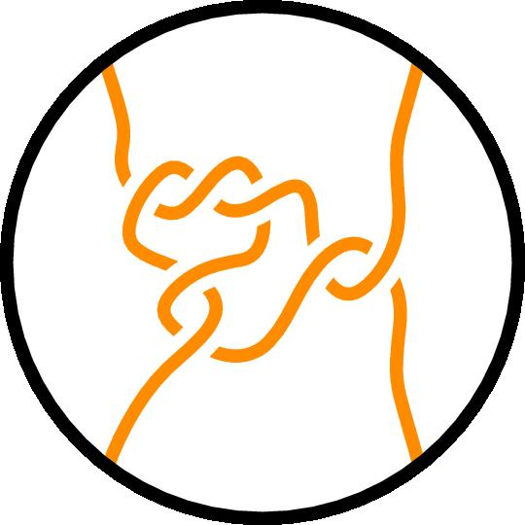
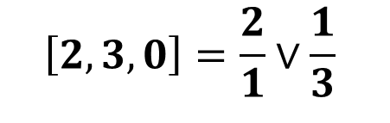
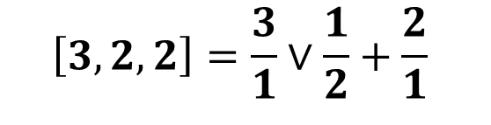
Conway Notation for Rational Tangles
$$\left[2,3,0\right]=\frac{2}{1}∨\frac{1}{3}$$
$$\left[3,2,2\right]=\frac{3}{1}∨\frac{1}{2}+\frac{2}{1}$$
Notes:
Maybe color code the twists and corresponding fractions

Slide 15
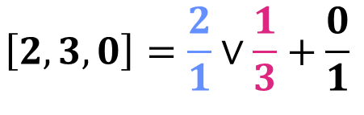
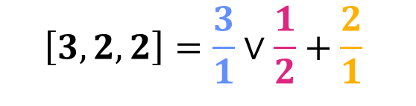
Conway Notation for Rational Tangles
$$\left[2,3,0\right]=\frac{2}{1}∨\frac{1}{3}+\frac{0}{1}$$
$$\left[3,2,2\right]=\frac{3}{1}∨\frac{1}{2}+\frac{2}{1}$$
Notes:
Maybe color code the twists and corresponding fractions

Slide 16
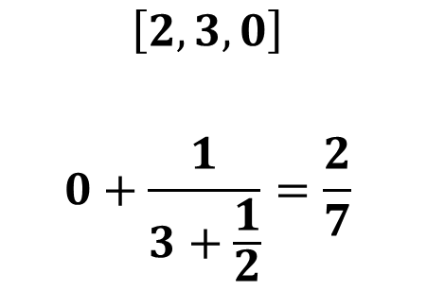
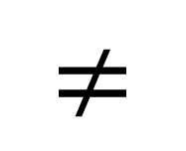
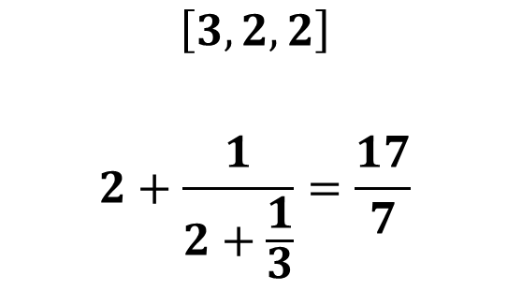
Continued Fraction for a Rational Tangle
$$≠$$
$$\left[2,3,0\right]$$
$$0+\frac{1}{3+\frac{1}{2}}=\frac{2}{7}$$
$$\left[3,2,2\right]$$
$$2+\frac{1}{2+\frac{1}{3}}=\frac{17}{7}$$
Notes:
Move things up when possible (TRY GOING INTO THE MASTER SLIDE AND MOVING THINGS UP)
Mirror

Slide 17
Counting and Generating Algebraic Tangles

Slide 18
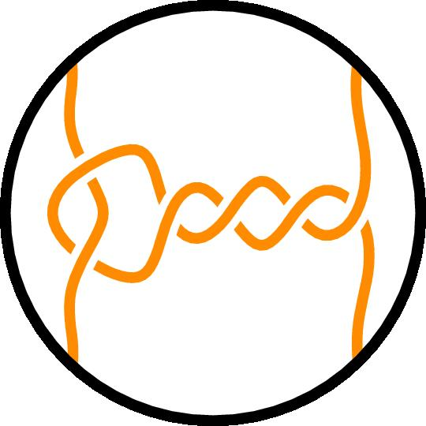
Free Boundary; The Only Rational Tangle
Notes:
0 is the true one rep for the free boundary rationals
Free/Fixed Boundary; ------

Slide 19
Free Boundary; The Only Rational Tangle
Notes:
0 is the true one rep for the free boundary rationals
Free/Fixed Boundary; ------

Slide 20
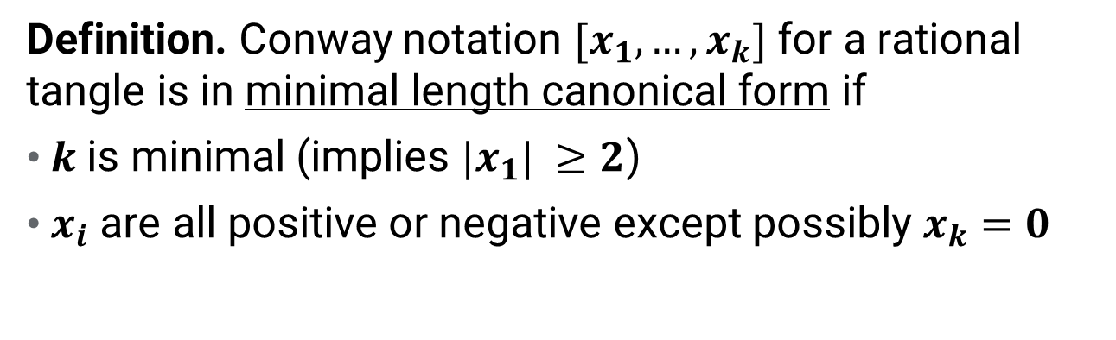

Fixed Boundary; Rational Tangles
Definition. Conway notation $[x_{1},…,x_{k}]$ for a rational tangle is in minimal length canonical form if
$k$ is minimal (implies $|x_{1}| ≥2$)
$x_{i}$ are all positive or negative except possibly $x_{k}=0$
There are odd length and even length canonical forms.
$$\left[1,x_{1}−1,…,x_{k}\right]=\left[x_{1},…,x_{k}\right]$$
Notes:
Discuss odd and even and minimal length.

Slide 21
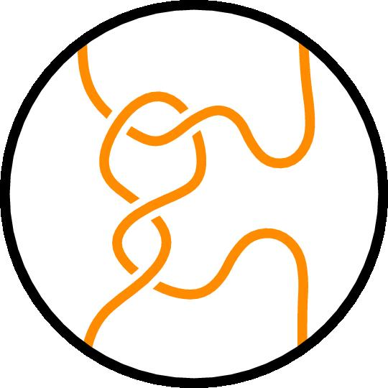
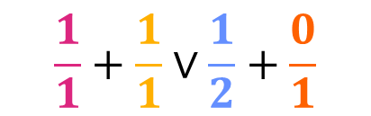


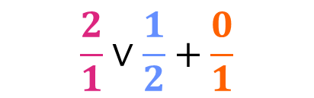

Fixed Boundary; Rational Tangles
$$\left[1,x_{1}−1,…,x_{k}\right]=\left[x_{1},…,x_{k}\right]$$
$$[1,1,2,0]$$
$$[2,2,0]$$
$$\frac{1}{1}+\frac{1}{1}∨\frac{1}{2}+\frac{0}{1}$$
$$\frac{2}{1}∨\frac{1}{2}+\frac{0}{1}$$
Notes:
Discuss odd and even and minimal length.

Slide 22
Fixed Boundary; Rational Tangles
Definition. Conway notation $[x_{1},…,x_{k}]$ for a rational tangle is in minimal length canonical form if
$k$ is minimal (implies $|x_{1}| ≥2$)
$x_{i}$ are all positive or negative except possibly $x_{k}=0$
There are odd length and even length canonical forms.
$$\left[1,x_{1}−1,…,x_{k}\right]=\left[x_{1},…,x_{k}\right]$$
Notes:
Discuss odd and even and minimal length.

Slide 23
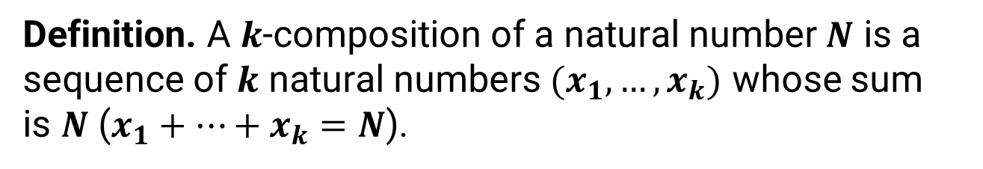
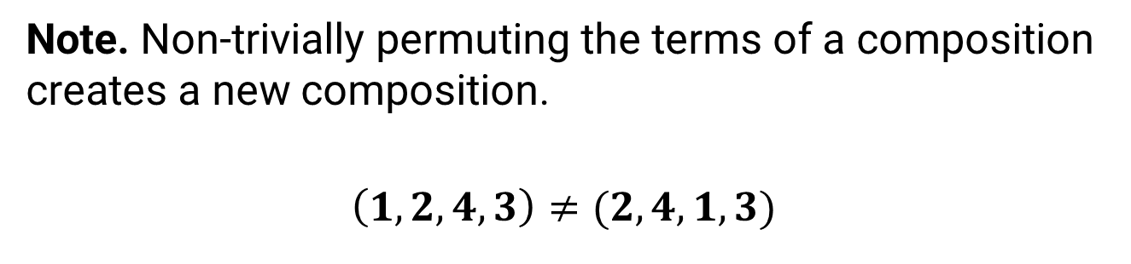
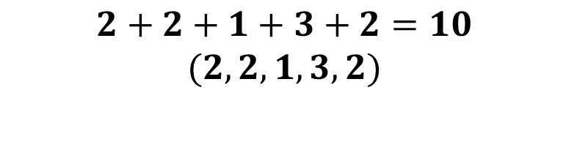
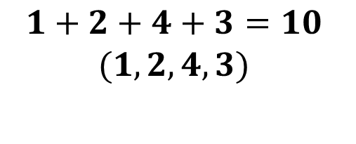
Fixed Boundary; Rational Tangles
Definition. A $k$-composition of a natural number $N$ is a sequence of $k$ natural numbers $(x_{1}, …, x_{k})$ whose sum is $N$ ($x_{1}+…+x_{k}=N$).
$$1+2+4+3=10$$
$$(1,2,4,3)$$
$$2+2+1+3+2=10$$
$$(2,2,1,3,2)$$
Note. Non-trivially permuting the terms of a composition creates a new composition.
$$\left(1,2,4,3\right)≠(2,4,1,3)$$
Notes:
A k-composition of an integer n is a sum x1 + … + xk = n where xi > 0 is an integer. A permutation of the summands creates a new composition.
We focus on rational tangles with all positive crossings, the mirrored versions may be found in a similar manner but because of cases
when a tangle is equivalent to its mirror, the total number of rational tangles with N crossings is not simply double the proposed count.
*I kinda think that since we have rational tangles where they are equivalent iff a1/b1 = a2/b2, there is no issue with mirrors and it is a true doubling*
Conway notation in canonical form for a rational tangle is equivalent to a k-composition of the total number of crossings in the tangle.
The number of k-compositions of an integer n is (n-1) choose (k-1), the total number of compositions of an integer is 2^(n-1).
Half of the total number of compositions start with a 1 and not allowed for canonical notation, but none include a terminating 0. We end up with 2^(n-1)
Unique rational tangles by removing the compositions which start with 1, then making a copy of the remaining compositions and including a 0.

Slide 24
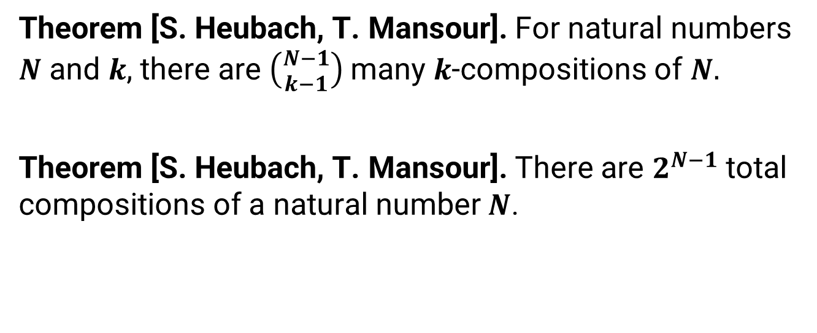
Fixed Boundary; Rational Tangles
Theorem [S. Heubach, T. Mansour]. For natural numbers $N$ and $k$, there are $\left({N−1 \atop k−1}\right)$ many $k$-compositions of $N.$
Theorem [S. Heubach, T. Mansour]. There are $2^{N−1}$ total compositions of a natural number $N$.
Notes:
INCLUDE CITATION FOR THE THEOREMS
A k-composition of an integer n is a sum x1 + … + xk = n where xi > 0 is an integer. A permutation of the summands creates a new composition.
We focus on rational tangles with all positive crossings, the mirrored versions may be found in a similar manner but because of cases
when a tangle is equivalent to its mirror, the total number of rational tangles with N crossings is not simply double the proposed count.
*I kinda think that since we have rational tangles where they are equivalent iff a1/b1 = a2/b2, there is no issue with mirrors and it is a true doubling*
Conway notation in canonical form for a rational tangle is equivalent to a k-composition of the total number of crossings in the tangle.
The number of k-compositions of an integer n is (n-1) choose (k-1), the total number of compositions of an integer is 2^(n-1).
Half of the total number of compositions start with a 1 and not allowed for canonical notation, but none include a terminating 0. We end up with 2^(n-1)
Unique rational tangles by removing the compositions which start with 1, then making a copy of the remaining compositions and including a 0.

Slide 25
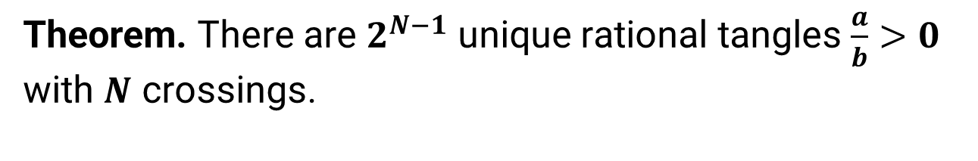
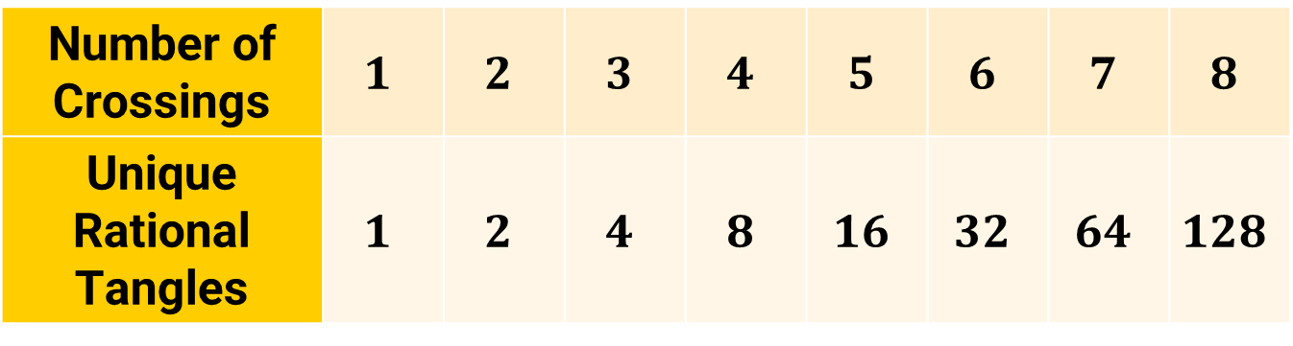
Fixed Boundary; Rational Tangles
Theorem. There are $2^{N−1}$ unique rational tangles $\frac{a}{b}>0$ with $N$ crossings.
Number of Crossings | $$1$$ | $$2$$ | $$3$$ | $$4$$ | $$5$$ | $$6$$ | $$7$$ | $$8$$
Unique Rational Tangles | $$1$$ | $$2$$ | $$4$$ | $$8$$ | $$16$$ | $$32$$ | $$64$$ | $$128$$
Notes:
A k-composition of an integer n is a sum x1 + … + xk = n where xi > 0 is an integer. A permutation of the summands creates a new composition.
We focus on rational tangles with all positive crossings, the mirrored versions may be found in a similar manner but because of cases
when a tangle is equivalent to its mirror, the total number of rational tangles with N crossings is not simply double the proposed count.
*I kinda think that since we have rational tangles where they are equivalent iff a1/b1 = a2/b2, there is no issue with mirrors and it is a true doubling*
Conway notation in canonical form for a rational tangle is equivalent to a k-composition of the total number of crossings in the tangle.
The number of k-compositions of an integer n is (n-1) choose (k-1), the total number of compositions of an integer is 2^(n-1).
Half of the total number of compositions start with a 1 and not allowed for canonical notation, but none include a terminating 0. We end up with 2^(n-1)
Unique rational tangles by removing the compositions which start with 1, then making a copy of the remaining compositions and including a 0.

Slide 26
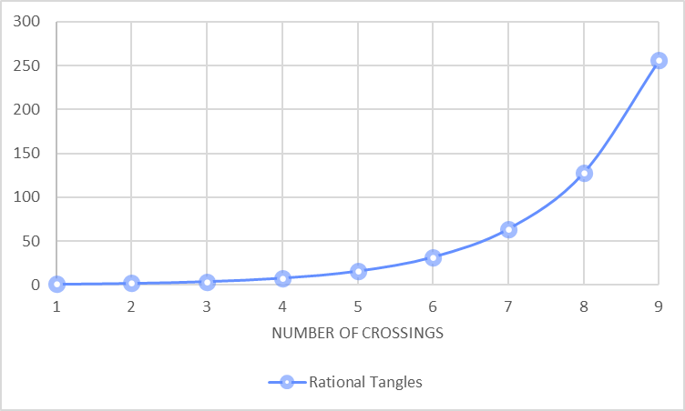
Fixed Boundary; Rational Tangles
Notes:
A k-composition of an integer n is a sum x1 + … + xk = n where xi > 0 is an integer. A permutation of the summands creates a new composition.
We focus on rational tangles with all positive crossings, the mirrored versions may be found in a similar manner but because of cases
when a tangle is equivalent to its mirror, the total number of rational tangles with N crossings is not simply double the proposed count.
*I kinda think that since we have rational tangles where they are equivalent iff a1/b1 = a2/b2, there is no issue with mirrors and it is a true doubling*
Conway notation in canonical form for a rational tangle is equivalent to a k-composition of the total number of crossings in the tangle.
The number of k-compositions of an integer n is (n-1) choose (k-1), the total number of compositions of an integer is 2^(n-1).
Half of the total number of compositions start with a 1 and not allowed for canonical notation, but none include a terminating 0. We end up with 2^(n-1)
Unique rational tangles by removing the compositions which start with 1, then making a copy of the remaining compositions and including a 0.

Slide 27
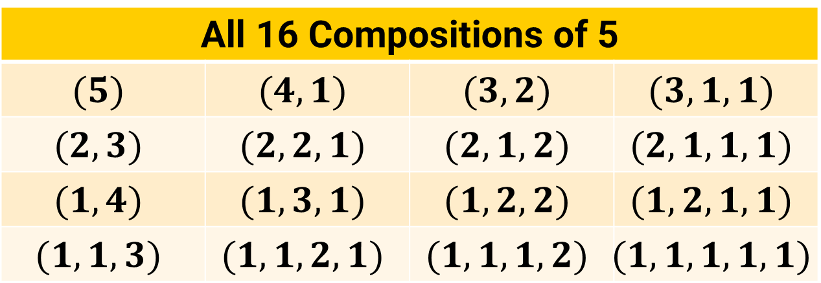
Fixed Boundary; Rational Tangles
$$\left[1,x_{1}−1,…,x_{k}\right]=\left[x_{1},…,x_{k}\right]$$
All 16 Compositions of 5
$$(5)$$ | $$(4,1)$$ | $$(3,2)$$ | $$(3,1,1)$$
$$(2,3)$$ | $$(2,2,1)$$ | $$(2,1,2)$$ | $$(2,1,1,1)$$
$$(1,4)$$ | $$(1,3,1)$$ | $$(1,2,2)$$ | $$(1,2,1,1)$$
$$(1,1,3)$$ | $$(1,1,2,1)$$ | $$(1,1,1,2)$$ | $$(1,1,1,1,1)$$
Notes:
REMIND THEM ABOUT [X1,…,XK] = [1,X1-1,…,XK]
CHANGE EVERY INDEX OF TWISTS TO K
A k-composition of an integer n is a sum x1 + … + xk = n where xi > 0 is an integer. A permutation of the summands creates a new composition.
We focus on rational tangles with all positive crossings, the mirrored versions may be found in a similar manner but because of cases
when a tangle is equivalent to its mirror, the total number of rational tangles with N crossings is not simply double the proposed count.
*I kinda think that since we have rational tangles where they are equivalent iff a1/b1 = a2/b2, there is no issue with mirrors and it is a true doubling*
Conway notation in canonical form for a rational tangle is equivalent to a k-composition of the total number of crossings in the tangle.
The number of k-compositions of an integer n is (n-1) choose (k-1), the total number of compositions of an integer is 2^(n-1).
Half of the total number of compositions start with a 1 and not allowed for canonical notation, but none include a terminating 0. We end up with 2^(n-1)
Unique rational tangles by removing the compositions which start with 1, then making a copy of the remaining compositions and including a 0.

Slide 28

Fixed Boundary; Rational Tangles
All 16 Unique Rational Tangles With 5 Crossings
$$[5]$$ | $$[4,1]$$ | $$[3,2]$$ | $$[3,1,1]$$
$$[2,3]$$ | $$[2,2,1]$$ | $$[2,1,2]$$ | $$[2,1,1,1]$$
$$[5,0]$$ | $$[4,1,0]$$ | $$[3,2,0]$$ | $$[3,1,1,0]$$
$$[2,3,0]$$ | $$[2,2,1,0]$$ | $$[2,1,2,0]$$ | $$[2,1,1,1,0]$$
Notes:
A k-composition of an integer n is a sum x1 + … + xk = n where xi > 0 is an integer. A permutation of the summands creates a new composition.
We focus on rational tangles with all positive crossings, the mirrored versions may be found in a similar manner but because of cases
when a tangle is equivalent to its mirror, the total number of rational tangles with N crossings is not simply double the proposed count.
*I kinda think that since we have rational tangles where they are equivalent iff a1/b1 = a2/b2, there is no issue with mirrors and it is a true doubling*
Conway notation in canonical form for a rational tangle is equivalent to a k-composition of the total number of crossings in the tangle.
The number of k-compositions of an integer n is (n-1) choose (k-1), the total number of compositions of an integer is 2^(n-1).
Half of the total number of compositions start with a 1 and not allowed for canonical notation, but none include a terminating 0. We end up with 2^(n-1)
Unique rational tangles by removing the compositions which start with 1, then making a copy of the remaining compositions and including a 0.

Slide 29



Montesinos Tangles
Definition. A Montesinos tangle is a horizontal sum of at least two rational tangles which are not the $∞$-tangle.

Slide 30


Free Boundary; Montesinos Tangles
A Montesinos tangle with free boundary in canonical form is expressed as a sum $M=\frac{a_{1}}{b_{1}}+…+\frac{a_{n}}{b_{n}}$ where $0<a_{i}<b_{i}$ for all $i.$
$$M=\frac{1}{3}+\frac{2}{3}+\frac{2}{5}$$
$$\left[3,0\right]+\left[2,1,0\right]+[2,2,0]$$
Notes:
A Montesinos tangle in canonical form M = a1/b1 + … + an/bn + x/1 can be thought of as a Montesinos tangle M’ = a1/b1 + … + an-1/bn-1 plus a rational tangle R = an/bn + x.
The number of crossings of M must be distributed across every summand of M (i.e. a composition of N where the c1,…,cn-1 term indicates the number of crossings in ai/bi of M’ and cn gives the number of crossings in R)
such that there are
a) at least two parts — else M is rational
b) each part is at least 2 — else M may be simplified to have fewer summands
c) N must be at least 4 — else M is rational
d) R must not be horizontal — else M may be simplified to have fewer summands
There are F(N-1)-1 compositions of N indicating the distribution of crossings.
If (c1,…,cn) is a composition of N, R may be any canonical *non-horizontal* rational tangle with cn positive or negative crossings.
There are 2(2^cn-1) = 2^cn unique choices, 2 of which are horizontal tangles thus 2^cn – 2 total acceptable choices of R.
The ai/bi in M’ must be canonical rational tangles with ci crossings and notation ending in a zero.
Of all rational tangles with ci crossings, half end in zero, so there are 2^(ci – 2) acceptable choices of ai/bi.
As a horizontal sum, these counts are independent thus the total number of Montesinos tangles with its crossings distributed
according to (c1,…,cn) is made as their product.
By summing over all possible compositions, we find the total number of unique Montesinos tangles with N crossings.

Slide 31






Free Boundary; Montesinos Tangles
If $M$ has
$$N=c_{1}+…+c_{n}$$
crossings
$$\frac{a_{1}}{b_{1}}$$
$$+⋯+$$
$$\frac{a_{n}}{b_{n}}$$
where $\frac{a_{i}}{b_{i}}$ has $c_{i}$ crossings
Notes:
A Montesinos tangle in canonical form M = a1/b1 + … + an/bn + x/1 can be thought of as a Montesinos tangle M’ = a1/b1 + … + an-1/bn-1 plus a rational tangle R = an/bn + x.
The number of crossings of M must be distributed across every summand of M (i.e. a composition of N where the c1,…,cn-1 term indicates the number of crossings in ai/bi of M’ and cn gives the number of crossings in R)
such that there are
a) at least two parts — else M is rational
b) each part is at least 2 — else M may be simplified to have fewer summands
c) N must be at least 4 — else M is rational
d) R must not be horizontal — else M may be simplified to have fewer summands
There are F(N-1)-1 compositions of N indicating the distribution of crossings.
If (c1,…,cn) is a composition of N, R may be any canonical *non-horizontal* rational tangle with cn positive or negative crossings.
There are 2(2^cn-1) = 2^cn unique choices, 2 of which are horizontal tangles thus 2^cn – 2 total acceptable choices of R.
The ai/bi in M’ must be canonical rational tangles with ci crossings and notation ending in a zero.
Of all rational tangles with ci crossings, half end in zero, so there are 2^(ci – 2) acceptable choices of ai/bi.
As a horizontal sum, these counts are independent thus the total number of Montesinos tangles with its crossings distributed
according to (c1,…,cn) is made as their product.
By summing over all possible compositions, we find the total number of unique Montesinos tangles with N crossings.

Slide 32


Free Boundary; Montesinos Tangles
There are $2^{c_{i}−1}$ rational tangles with $c_{i}$ crossings
$$\frac{a_{1}}{b_{1}}$$
$$+⋯+$$
$$\frac{a_{n}}{b_{n}}$$
Only half ($2^{c_{i}−2}$) end with vertical twists
Notes:
A Montesinos tangle in canonical form M = a1/b1 + … + an/bn + x/1 can be thought of as a Montesinos tangle M’ = a1/b1 + … + an-1/bn-1 plus a rational tangle R = an/bn + x.
The number of crossings of M must be distributed across every summand of M (i.e. a composition of N where the c1,…,cn-1 term indicates the number of crossings in ai/bi of M’ and cn gives the number of crossings in R)
such that there are
a) at least two parts — else M is rational
b) each part is at least 2 — else M may be simplified to have fewer summands
c) N must be at least 4 — else M is rational
d) R must not be horizontal — else M may be simplified to have fewer summands
There are F(N-1)-1 compositions of N indicating the distribution of crossings.
If (c1,…,cn) is a composition of N, R may be any canonical *non-horizontal* rational tangle with cn positive or negative crossings.
There are 2(2^cn-1) = 2^cn unique choices, 2 of which are horizontal tangles thus 2^cn – 2 total acceptable choices of R.
The ai/bi in M’ must be canonical rational tangles with ci crossings and notation ending in a zero.
Of all rational tangles with ci crossings, half end in zero, so there are 2^(ci – 2) acceptable choices of ai/bi.
As a horizontal sum, these counts are independent thus the total number of Montesinos tangles with its crossings distributed
according to (c1,…,cn) is made as their product.
By summing over all possible compositions, we find the total number of unique Montesinos tangles with N crossings.

Slide 33




Free Boundary; Montesinos Tangles
$$\frac{a_{1}}{b_{1}}$$
$$+⋯+$$
$$\frac{a_{n}}{b_{n}}$$
$$2^{c_{1}−2}⋯2^{c_{n}−2}$$
Notes:
A Montesinos tangle in canonical form M = a1/b1 + … + an/bn + x/1 can be thought of as a Montesinos tangle M’ = a1/b1 + … + an-1/bn-1 plus a rational tangle R = an/bn + x.
The number of crossings of M must be distributed across every summand of M (i.e. a composition of N where the c1,…,cn-1 term indicates the number of crossings in ai/bi of M’ and cn gives the number of crossings in R)
such that there are
a) at least two parts — else M is rational
b) each part is at least 2 — else M may be simplified to have fewer summands
c) N must be at least 4 — else M is rational
d) R must not be horizontal — else M may be simplified to have fewer summands
There are F(N-1)-1 compositions of N indicating the distribution of crossings.
If (c1,…,cn) is a composition of N, R may be any canonical *non-horizontal* rational tangle with cn positive or negative crossings.
There are 2(2^cn-1) = 2^cn unique choices, 2 of which are horizontal tangles thus 2^cn – 2 total acceptable choices of R.
The ai/bi in M’ must be canonical rational tangles with ci crossings and notation ending in a zero.
Of all rational tangles with ci crossings, half end in zero, so there are 2^(ci – 2) acceptable choices of ai/bi.
As a horizontal sum, these counts are independent thus the total number of Montesinos tangles with its crossings distributed
according to (c1,…,cn) is made as their product.
By summing over all possible compositions, we find the total number of unique Montesinos tangles with N crossings.

Slide 34


Free Boundary; Montesinos Tangles
Theorem [R. Stanley]. For a natural number $N$, there are $F_{N−1}$ compositions of $N$ into parts greater than 1 where $F_{N−1}$ is the ${\left(N−1\right)}^{th}$ term in the Fibonacci sequence.
Fibonacci Sequence
$$F_{0}$$ | $$F_{1}$$ | $$F_{2}$$ | $$F_{3}$$ | $$F_{4}$$ | $$F_{5}$$ | $$F_{6}$$
$$0$$ | $$1$$ | $$1$$ | $$2$$ | $$3$$ | $$5$$ | $$8$$
Notes:
A Montesinos tangle in canonical form M = a1/b1 + … + an/bn + x/1 can be thought of as a Montesinos tangle M’ = a1/b1 + … + an-1/bn-1 plus a rational tangle R = an/bn + x.
The number of crossings of M must be distributed across every summand of M (i.e. a composition of N where the c1,…,cn-1 term indicates the number of crossings in ai/bi of M’ and cn gives the number of crossings in R)
such that there are
a) at least two parts — else M is rational
b) each part is at least 2 — else M may be simplified to have fewer summands
c) N must be at least 4 — else M is rational
d) R must not be horizontal — else M may be simplified to have fewer summands
There are F(N-1)-1 compositions of N indicating the distribution of crossings.
If (c1,…,cn) is a composition of N, R may be any canonical *non-horizontal* rational tangle with cn positive or negative crossings.
There are 2(2^cn-1) = 2^cn unique choices, 2 of which are horizontal tangles thus 2^cn – 2 total acceptable choices of R.
The ai/bi in M’ must be canonical rational tangles with ci crossings and notation ending in a zero.
Of all rational tangles with ci crossings, half end in zero, so there are 2^(ci – 2) acceptable choices of ai/bi.
As a horizontal sum, these counts are independent thus the total number of Montesinos tangles with its crossings distributed
according to (c1,…,cn) is made as their product.
By summing over all possible compositions, we find the total number of unique Montesinos tangles with N crossings.

Slide 35

Free Boundary; Montesinos Tangles
Theorem [B]. The number of unique Montesinos tangles with free boundary and $N$ crossings is given by the sum
$$\sum_{C_{j}=\left(c_{1},…,c_{n_{j}}\right)}{\left(\prod_{i=1}^{n_{j}}{2^{c_{i}−2}}\right)}$$
over all $F_{N−1}−1$ compositions $C_{j}$ of $N≥4$ into at least two parts greater than 1.
Notes:
A Montesinos tangle in canonical form M = a1/b1 + … + an/bn + x/1 can be thought of as a Montesinos tangle M’ = a1/b1 + … + an-1/bn-1 plus a rational tangle R = an/bn + x.
The number of crossings of M must be distributed across every summand of M (i.e. a composition of N where the c1,…,cn-1 term indicates the number of crossings in ai/bi of M’ and cn gives the number of crossings in R)
such that there are
a) at least two parts — else M is rational
b) each part is at least 2 — else M may be simplified to have fewer summands
c) N must be at least 4 — else M is rational
d) R must not be horizontal — else M may be simplified to have fewer summands
There are F(N-1)-1 compositions of N indicating the distribution of crossings.
If (c1,…,cn) is a composition of N, R may be any canonical *non-horizontal* rational tangle with cn positive or negative crossings.
There are 2(2^cn-1) = 2^cn unique choices, 2 of which are horizontal tangles thus 2^cn – 2 total acceptable choices of R.
The ai/bi in M’ must be canonical rational tangles with ci crossings and notation ending in a zero.
Of all rational tangles with ci crossings, half end in zero, so there are 2^(ci – 2) acceptable choices of ai/bi.
As a horizontal sum, these counts are independent thus the total number of Montesinos tangles with its crossings distributed
according to (c1,…,cn) is made as their product.
By summing over all possible compositions, we find the total number of unique Montesinos tangles with N crossings.

Slide 36

Free Boundary; Montesinos Tangles
Number of Crossings | $$4$$ | $$5$$ | $$6$$ | $$7$$ | $$8$$ | $$9$$
Unique Montesinos Tangles | $$1$$ | $$4$$ | $$13$$ | $$38$$ | $$105$$ | $$280$$
Notes:
A Montesinos tangle in canonical form M = a1/b1 + … + an/bn + x/1 can be thought of as a Montesinos tangle M’ = a1/b1 + … + an-1/bn-1 plus a rational tangle R = an/bn + x.
The number of crossings of M must be distributed across every summand of M (i.e. a composition of N where the c1,…,cn-1 term indicates the number of crossings in ai/bi of M’ and cn gives the number of crossings in R)
such that there are
a) at least two parts — else M is rational
b) each part is at least 2 — else M may be simplified to have fewer summands
c) N must be at least 4 — else M is rational
d) R must not be horizontal — else M may be simplified to have fewer summands
There are F(N-1)-1 compositions of N indicating the distribution of crossings.
If (c1,…,cn) is a composition of N, R may be any canonical *non-horizontal* rational tangle with cn positive or negative crossings.
There are 2(2^cn-1) = 2^cn unique choices, 2 of which are horizontal tangles thus 2^cn – 2 total acceptable choices of R.
The ai/bi in M’ must be canonical rational tangles with ci crossings and notation ending in a zero.
Of all rational tangles with ci crossings, half end in zero, so there are 2^(ci – 2) acceptable choices of ai/bi.
As a horizontal sum, these counts are independent thus the total number of Montesinos tangles with its crossings distributed
according to (c1,…,cn) is made as their product.
By summing over all possible compositions, we find the total number of unique Montesinos tangles with N crossings.

Slide 37

Free Boundary; Montesinos Tangles
Notes:
A Montesinos tangle in canonical form M = a1/b1 + … + an/bn + x/1 can be thought of as a Montesinos tangle M’ = a1/b1 + … + an-1/bn-1 plus a rational tangle R = an/bn + x.
The number of crossings of M must be distributed across every summand of M (i.e. a composition of N where the c1,…,cn-1 term indicates the number of crossings in ai/bi of M’ and cn gives the number of crossings in R)
such that there are
a) at least two parts — else M is rational
b) each part is at least 2 — else M may be simplified to have fewer summands
c) N must be at least 4 — else M is rational
d) R must not be horizontal — else M may be simplified to have fewer summands
There are F(N-1)-1 compositions of N indicating the distribution of crossings.
If (c1,…,cn) is a composition of N, R may be any canonical *non-horizontal* rational tangle with cn positive or negative crossings.
There are 2(2^cn-1) = 2^cn unique choices, 2 of which are horizontal tangles thus 2^cn – 2 total acceptable choices of R.
The ai/bi in M’ must be canonical rational tangles with ci crossings and notation ending in a zero.
Of all rational tangles with ci crossings, half end in zero, so there are 2^(ci – 2) acceptable choices of ai/bi.
As a horizontal sum, these counts are independent thus the total number of Montesinos tangles with its crossings distributed
according to (c1,…,cn) is made as their product.
By summing over all possible compositions, we find the total number of unique Montesinos tangles with N crossings.

Slide 38


Free Boundary; Montesinos Tangles
There are $F_{5}=5$ compositions of $6$ into parts greater than $1$.
We only want compositions with at least $2$ parts.
All Compositions of 6 Into Parts Greater Than 1
$$(6)$$ | $$(4,2)$$ | $$(3,3)$$ | $$(2,4)$$ | $$(2,2,2)$$
Notes:
A Montesinos tangle in canonical form M = a1/b1 + … + an/bn + x/1 can be thought of as a Montesinos tangle M’ = a1/b1 + … + an-1/bn-1 plus a rational tangle R = an/bn + x.
The number of crossings of M must be distributed across every summand of M (i.e. a composition of N where the c1,…,cn-1 term indicates the number of crossings in ai/bi of M’ and cn gives the number of crossings in R)
such that there are
a) at least two parts — else M is rational
b) each part is at least 2 — else M may be simplified to have fewer summands
c) N must be at least 4 — else M is rational
d) R must not be horizontal — else M may be simplified to have fewer summands
There are F(N-1)-1 compositions of N indicating the distribution of crossings.
If (c1,…,cn) is a composition of N, R may be any canonical *non-horizontal* rational tangle with cn positive or negative crossings.
There are 2(2^cn-1) = 2^cn unique choices, 2 of which are horizontal tangles thus 2^cn – 2 total acceptable choices of R.
The ai/bi in M’ must be canonical rational tangles with ci crossings and notation ending in a zero.
Of all rational tangles with ci crossings, half end in zero, so there are 2^(ci – 2) acceptable choices of ai/bi.
As a horizontal sum, these counts are independent thus the total number of Montesinos tangles with its crossings distributed
according to (c1,…,cn) is made as their product.
By summing over all possible compositions, we find the total number of unique Montesinos tangles with N crossings.

Slide 39





Free Boundary; Montesinos Tangles
$$\sum_{C_{j}=\left(c_{1},…,c_{n_{j}}\right)}{\left(\prod_{i=1}^{n_{j}}{2^{c_{i}−2}}\right)}$$
$$C_{1}=(4,2)$$
$$2^{2}⋅2^{0}=4$$
$1$ of $4$
Notes:
Add a slide showing all F_(N-1)-1 comps of 6 to justify.
Include formula into these slides to make its usage clear

Slide 40


Free Boundary; Montesinos Tangles
$$\sum_{C_{j}=\left(c_{1},…,c_{n_{j}}\right)}{\left(\prod_{i=1}^{n_{j}}{2^{c_{i}−2}}\right)}$$
$$C_{1}=(4,2)$$
$$2^{2}⋅2^{0}=4$$
$2$ of $4$
Notes:
A Montesinos tangle in canonical form M = a1/b1 + … + an/bn + x/1 can be thought of as a Montesinos tangle M’ = a1/b1 + … + an-1/bn-1 plus a rational tangle R = an/bn + x.
The number of crossings of M must be distributed across every summand of M (i.e. a composition of N where the c1,…,cn-1 term indicates the number of crossings in ai/bi of M’ and cn gives the number of crossings in R)
such that there are
a) at least two parts — else M is rational
b) each part is at least 2 — else M may be simplified to have fewer summands
c) N must be at least 4 — else M is rational
d) R must not be horizontal — else M may be simplified to have fewer summands
There are F(N-1)-1 compositions of N indicating the distribution of crossings.
If (c1,…,cn) is a composition of N, R may be any canonical *non-horizontal* rational tangle with cn positive or negative crossings.
There are 2(2^cn-1) = 2^cn unique choices, 2 of which are horizontal tangles thus 2^cn – 2 total acceptable choices of R.
The ai/bi in M’ must be canonical rational tangles with ci crossings and notation ending in a zero.
Of all rational tangles with ci crossings, half end in zero, so there are 2^(ci – 2) acceptable choices of ai/bi.
As a horizontal sum, these counts are independent thus the total number of Montesinos tangles with its crossings distributed
according to (c1,…,cn) is made as their product.
By summing over all possible compositions, we find the total number of unique Montesinos tangles with N crossings.

Slide 41


Free Boundary; Montesinos Tangles
$$\sum_{C_{j}=\left(c_{1},…,c_{n_{j}}\right)}{\left(\prod_{i=1}^{n_{j}}{2^{c_{i}−2}}\right)}$$
$$C_{1}=(4,2)$$
$$2^{2}⋅2^{0}=4$$
$3$ of $4$
Notes:
A Montesinos tangle in canonical form M = a1/b1 + … + an/bn + x/1 can be thought of as a Montesinos tangle M’ = a1/b1 + … + an-1/bn-1 plus a rational tangle R = an/bn + x.
The number of crossings of M must be distributed across every summand of M (i.e. a composition of N where the c1,…,cn-1 term indicates the number of crossings in ai/bi of M’ and cn gives the number of crossings in R)
such that there are
a) at least two parts — else M is rational
b) each part is at least 2 — else M may be simplified to have fewer summands
c) N must be at least 4 — else M is rational
d) R must not be horizontal — else M may be simplified to have fewer summands
There are F(N-1)-1 compositions of N indicating the distribution of crossings.
If (c1,…,cn) is a composition of N, R may be any canonical *non-horizontal* rational tangle with cn positive or negative crossings.
There are 2(2^cn-1) = 2^cn unique choices, 2 of which are horizontal tangles thus 2^cn – 2 total acceptable choices of R.
The ai/bi in M’ must be canonical rational tangles with ci crossings and notation ending in a zero.
Of all rational tangles with ci crossings, half end in zero, so there are 2^(ci – 2) acceptable choices of ai/bi.
As a horizontal sum, these counts are independent thus the total number of Montesinos tangles with its crossings distributed
according to (c1,…,cn) is made as their product.
By summing over all possible compositions, we find the total number of unique Montesinos tangles with N crossings.

Slide 42


Free Boundary; Montesinos Tangles
$$\sum_{C_{j}=\left(c_{1},…,c_{n_{j}}\right)}{\left(\prod_{i=1}^{n_{j}}{2^{c_{i}−2}}\right)}$$
$$C_{1}=(4,2)$$
$$2^{2}⋅2^{0}=4$$
$4$ of $4$
Notes:
A Montesinos tangle in canonical form M = a1/b1 + … + an/bn + x/1 can be thought of as a Montesinos tangle M’ = a1/b1 + … + an-1/bn-1 plus a rational tangle R = an/bn + x.
The number of crossings of M must be distributed across every summand of M (i.e. a composition of N where the c1,…,cn-1 term indicates the number of crossings in ai/bi of M’ and cn gives the number of crossings in R)
such that there are
a) at least two parts — else M is rational
b) each part is at least 2 — else M may be simplified to have fewer summands
c) N must be at least 4 — else M is rational
d) R must not be horizontal — else M may be simplified to have fewer summands
There are F(N-1)-1 compositions of N indicating the distribution of crossings.
If (c1,…,cn) is a composition of N, R may be any canonical *non-horizontal* rational tangle with cn positive or negative crossings.
There are 2(2^cn-1) = 2^cn unique choices, 2 of which are horizontal tangles thus 2^cn – 2 total acceptable choices of R.
The ai/bi in M’ must be canonical rational tangles with ci crossings and notation ending in a zero.
Of all rational tangles with ci crossings, half end in zero, so there are 2^(ci – 2) acceptable choices of ai/bi.
As a horizontal sum, these counts are independent thus the total number of Montesinos tangles with its crossings distributed
according to (c1,…,cn) is made as their product.
By summing over all possible compositions, we find the total number of unique Montesinos tangles with N crossings.

Slide 43



Free Boundary; Montesinos Tangles
$$\sum_{C_{j}=\left(c_{1},…,c_{n_{j}}\right)}{\left(\prod_{i=1}^{n_{j}}{2^{c_{i}−2}}\right)}$$
$$C_{2}=(3,3)$$
$$2^{1}⋅2^{1}=4$$
$1$ of $4$
Notes:
A Montesinos tangle in canonical form M = a1/b1 + … + an/bn + x/1 can be thought of as a Montesinos tangle M’ = a1/b1 + … + an-1/bn-1 plus a rational tangle R = an/bn + x.
The number of crossings of M must be distributed across every summand of M (i.e. a composition of N where the c1,…,cn-1 term indicates the number of crossings in ai/bi of M’ and cn gives the number of crossings in R)
such that there are
a) at least two parts — else M is rational
b) each part is at least 2 — else M may be simplified to have fewer summands
c) N must be at least 4 — else M is rational
d) R must not be horizontal — else M may be simplified to have fewer summands
There are F(N-1)-1 compositions of N indicating the distribution of crossings.
If (c1,…,cn) is a composition of N, R may be any canonical *non-horizontal* rational tangle with cn positive or negative crossings.
There are 2(2^cn-1) = 2^cn unique choices, 2 of which are horizontal tangles thus 2^cn – 2 total acceptable choices of R.
The ai/bi in M’ must be canonical rational tangles with ci crossings and notation ending in a zero.
Of all rational tangles with ci crossings, half end in zero, so there are 2^(ci – 2) acceptable choices of ai/bi.
As a horizontal sum, these counts are independent thus the total number of Montesinos tangles with its crossings distributed
according to (c1,…,cn) is made as their product.
By summing over all possible compositions, we find the total number of unique Montesinos tangles with N crossings.

Slide 44

Free Boundary; Montesinos Tangles
$$\sum_{C_{j}=\left(c_{1},…,c_{n_{j}}\right)}{\left(\prod_{i=1}^{n_{j}}{2^{c_{i}−2}}\right)}$$
$$C_{2}=(3,3)$$
$$2^{1}⋅2^{1}=4$$
$2$ of $4$
Notes:
A Montesinos tangle in canonical form M = a1/b1 + … + an/bn + x/1 can be thought of as a Montesinos tangle M’ = a1/b1 + … + an-1/bn-1 plus a rational tangle R = an/bn + x.
The number of crossings of M must be distributed across every summand of M (i.e. a composition of N where the c1,…,cn-1 term indicates the number of crossings in ai/bi of M’ and cn gives the number of crossings in R)
such that there are
a) at least two parts — else M is rational
b) each part is at least 2 — else M may be simplified to have fewer summands
c) N must be at least 4 — else M is rational
d) R must not be horizontal — else M may be simplified to have fewer summands
There are F(N-1)-1 compositions of N indicating the distribution of crossings.
If (c1,…,cn) is a composition of N, R may be any canonical *non-horizontal* rational tangle with cn positive or negative crossings.
There are 2(2^cn-1) = 2^cn unique choices, 2 of which are horizontal tangles thus 2^cn – 2 total acceptable choices of R.
The ai/bi in M’ must be canonical rational tangles with ci crossings and notation ending in a zero.
Of all rational tangles with ci crossings, half end in zero, so there are 2^(ci – 2) acceptable choices of ai/bi.
As a horizontal sum, these counts are independent thus the total number of Montesinos tangles with its crossings distributed
according to (c1,…,cn) is made as their product.
By summing over all possible compositions, we find the total number of unique Montesinos tangles with N crossings.

Slide 45

Free Boundary; Montesinos Tangles
$$\sum_{C_{j}=\left(c_{1},…,c_{n_{j}}\right)}{\left(\prod_{i=1}^{n_{j}}{2^{c_{i}−2}}\right)}$$
$$C_{2}=(3,3)$$
$$2^{1}⋅2^{1}=4$$
$3$ of $4$
Notes:
A Montesinos tangle in canonical form M = a1/b1 + … + an/bn + x/1 can be thought of as a Montesinos tangle M’ = a1/b1 + … + an-1/bn-1 plus a rational tangle R = an/bn + x.
The number of crossings of M must be distributed across every summand of M (i.e. a composition of N where the c1,…,cn-1 term indicates the number of crossings in ai/bi of M’ and cn gives the number of crossings in R)
such that there are
a) at least two parts — else M is rational
b) each part is at least 2 — else M may be simplified to have fewer summands
c) N must be at least 4 — else M is rational
d) R must not be horizontal — else M may be simplified to have fewer summands
There are F(N-1)-1 compositions of N indicating the distribution of crossings.
If (c1,…,cn) is a composition of N, R may be any canonical *non-horizontal* rational tangle with cn positive or negative crossings.
There are 2(2^cn-1) = 2^cn unique choices, 2 of which are horizontal tangles thus 2^cn – 2 total acceptable choices of R.
The ai/bi in M’ must be canonical rational tangles with ci crossings and notation ending in a zero.
Of all rational tangles with ci crossings, half end in zero, so there are 2^(ci – 2) acceptable choices of ai/bi.
As a horizontal sum, these counts are independent thus the total number of Montesinos tangles with its crossings distributed
according to (c1,…,cn) is made as their product.
By summing over all possible compositions, we find the total number of unique Montesinos tangles with N crossings.

Slide 46

Free Boundary; Montesinos Tangles
$$\sum_{C_{j}=\left(c_{1},…,c_{n_{j}}\right)}{\left(\prod_{i=1}^{n_{j}}{2^{c_{i}−2}}\right)}$$
$$C_{2}=(3,3)$$
$$2^{1}⋅2^{1}=4$$
$4$ of $4$
Notes:
A Montesinos tangle in canonical form M = a1/b1 + … + an/bn + x/1 can be thought of as a Montesinos tangle M’ = a1/b1 + … + an-1/bn-1 plus a rational tangle R = an/bn + x.
The number of crossings of M must be distributed across every summand of M (i.e. a composition of N where the c1,…,cn-1 term indicates the number of crossings in ai/bi of M’ and cn gives the number of crossings in R)
such that there are
a) at least two parts — else M is rational
b) each part is at least 2 — else M may be simplified to have fewer summands
c) N must be at least 4 — else M is rational
d) R must not be horizontal — else M may be simplified to have fewer summands
There are F(N-1)-1 compositions of N indicating the distribution of crossings.
If (c1,…,cn) is a composition of N, R may be any canonical *non-horizontal* rational tangle with cn positive or negative crossings.
There are 2(2^cn-1) = 2^cn unique choices, 2 of which are horizontal tangles thus 2^cn – 2 total acceptable choices of R.
The ai/bi in M’ must be canonical rational tangles with ci crossings and notation ending in a zero.
Of all rational tangles with ci crossings, half end in zero, so there are 2^(ci – 2) acceptable choices of ai/bi.
As a horizontal sum, these counts are independent thus the total number of Montesinos tangles with its crossings distributed
according to (c1,…,cn) is made as their product.
By summing over all possible compositions, we find the total number of unique Montesinos tangles with N crossings.

Slide 47



Free Boundary; Montesinos Tangles
$$\sum_{C_{j}=\left(c_{1},…,c_{n_{j}}\right)}{\left(\prod_{i=1}^{n_{j}}{2^{c_{i}−2}}\right)}$$
$$C_{3}=(2,4)$$
$$2^{0}⋅2^{2}=4$$
$1$ of $4$
Notes:
A Montesinos tangle in canonical form M = a1/b1 + … + an/bn + x/1 can be thought of as a Montesinos tangle M’ = a1/b1 + … + an-1/bn-1 plus a rational tangle R = an/bn + x.
The number of crossings of M must be distributed across every summand of M (i.e. a composition of N where the c1,…,cn-1 term indicates the number of crossings in ai/bi of M’ and cn gives the number of crossings in R)
such that there are
a) at least two parts — else M is rational
b) each part is at least 2 — else M may be simplified to have fewer summands
c) N must be at least 4 — else M is rational
d) R must not be horizontal — else M may be simplified to have fewer summands
There are F(N-1)-1 compositions of N indicating the distribution of crossings.
If (c1,…,cn) is a composition of N, R may be any canonical *non-horizontal* rational tangle with cn positive or negative crossings.
There are 2(2^cn-1) = 2^cn unique choices, 2 of which are horizontal tangles thus 2^cn – 2 total acceptable choices of R.
The ai/bi in M’ must be canonical rational tangles with ci crossings and notation ending in a zero.
Of all rational tangles with ci crossings, half end in zero, so there are 2^(ci – 2) acceptable choices of ai/bi.
As a horizontal sum, these counts are independent thus the total number of Montesinos tangles with its crossings distributed
according to (c1,…,cn) is made as their product.
By summing over all possible compositions, we find the total number of unique Montesinos tangles with N crossings.

Slide 48

Free Boundary; Montesinos Tangles
$$\sum_{C_{j}=\left(c_{1},…,c_{n_{j}}\right)}{\left(\prod_{i=1}^{n_{j}}{2^{c_{i}−2}}\right)}$$
$$C_{3}=(2,4)$$
$$2^{0}⋅2^{2}=4$$
$2$ of $4$
Notes:
A Montesinos tangle in canonical form M = a1/b1 + … + an/bn + x/1 can be thought of as a Montesinos tangle M’ = a1/b1 + … + an-1/bn-1 plus a rational tangle R = an/bn + x.
The number of crossings of M must be distributed across every summand of M (i.e. a composition of N where the c1,…,cn-1 term indicates the number of crossings in ai/bi of M’ and cn gives the number of crossings in R)
such that there are
a) at least two parts — else M is rational
b) each part is at least 2 — else M may be simplified to have fewer summands
c) N must be at least 4 — else M is rational
d) R must not be horizontal — else M may be simplified to have fewer summands
There are F(N-1)-1 compositions of N indicating the distribution of crossings.
If (c1,…,cn) is a composition of N, R may be any canonical *non-horizontal* rational tangle with cn positive or negative crossings.
There are 2(2^cn-1) = 2^cn unique choices, 2 of which are horizontal tangles thus 2^cn – 2 total acceptable choices of R.
The ai/bi in M’ must be canonical rational tangles with ci crossings and notation ending in a zero.
Of all rational tangles with ci crossings, half end in zero, so there are 2^(ci – 2) acceptable choices of ai/bi.
As a horizontal sum, these counts are independent thus the total number of Montesinos tangles with its crossings distributed
according to (c1,…,cn) is made as their product.
By summing over all possible compositions, we find the total number of unique Montesinos tangles with N crossings.

Slide 49

Free Boundary; Montesinos Tangles
$$\sum_{C_{j}=\left(c_{1},…,c_{n_{j}}\right)}{\left(\prod_{i=1}^{n_{j}}{2^{c_{i}−2}}\right)}$$
$$C_{3}=(2,4)$$
$$2^{0}⋅2^{2}=4$$
$3$ of $4$
Notes:
A Montesinos tangle in canonical form M = a1/b1 + … + an/bn + x/1 can be thought of as a Montesinos tangle M’ = a1/b1 + … + an-1/bn-1 plus a rational tangle R = an/bn + x.
The number of crossings of M must be distributed across every summand of M (i.e. a composition of N where the c1,…,cn-1 term indicates the number of crossings in ai/bi of M’ and cn gives the number of crossings in R)
such that there are
a) at least two parts — else M is rational
b) each part is at least 2 — else M may be simplified to have fewer summands
c) N must be at least 4 — else M is rational
d) R must not be horizontal — else M may be simplified to have fewer summands
There are F(N-1)-1 compositions of N indicating the distribution of crossings.
If (c1,…,cn) is a composition of N, R may be any canonical *non-horizontal* rational tangle with cn positive or negative crossings.
There are 2(2^cn-1) = 2^cn unique choices, 2 of which are horizontal tangles thus 2^cn – 2 total acceptable choices of R.
The ai/bi in M’ must be canonical rational tangles with ci crossings and notation ending in a zero.
Of all rational tangles with ci crossings, half end in zero, so there are 2^(ci – 2) acceptable choices of ai/bi.
As a horizontal sum, these counts are independent thus the total number of Montesinos tangles with its crossings distributed
according to (c1,…,cn) is made as their product.
By summing over all possible compositions, we find the total number of unique Montesinos tangles with N crossings.

Slide 50

Free Boundary; Montesinos Tangles
$$\sum_{C_{j}=\left(c_{1},…,c_{n_{j}}\right)}{\left(\prod_{i=1}^{n_{j}}{2^{c_{i}−2}}\right)}$$
$$C_{3}=(2,4)$$
$$2^{0}⋅2^{2}=4$$
$4$ of $4$
Notes:
A Montesinos tangle in canonical form M = a1/b1 + … + an/bn + x/1 can be thought of as a Montesinos tangle M’ = a1/b1 + … + an-1/bn-1 plus a rational tangle R = an/bn + x.
The number of crossings of M must be distributed across every summand of M (i.e. a composition of N where the c1,…,cn-1 term indicates the number of crossings in ai/bi of M’ and cn gives the number of crossings in R)
such that there are
a) at least two parts — else M is rational
b) each part is at least 2 — else M may be simplified to have fewer summands
c) N must be at least 4 — else M is rational
d) R must not be horizontal — else M may be simplified to have fewer summands
There are F(N-1)-1 compositions of N indicating the distribution of crossings.
If (c1,…,cn) is a composition of N, R may be any canonical *non-horizontal* rational tangle with cn positive or negative crossings.
There are 2(2^cn-1) = 2^cn unique choices, 2 of which are horizontal tangles thus 2^cn – 2 total acceptable choices of R.
The ai/bi in M’ must be canonical rational tangles with ci crossings and notation ending in a zero.
Of all rational tangles with ci crossings, half end in zero, so there are 2^(ci – 2) acceptable choices of ai/bi.
As a horizontal sum, these counts are independent thus the total number of Montesinos tangles with its crossings distributed
according to (c1,…,cn) is made as their product.
By summing over all possible compositions, we find the total number of unique Montesinos tangles with N crossings.

Slide 51




Free Boundary; Montesinos Tangles
$$\sum_{C_{j}=\left(c_{1},…,c_{n_{j}}\right)}{\left(\prod_{i=1}^{n_{j}}{2^{c_{i}−2}}\right)}$$
$$C_{4}=(2,2,2)$$
$$2^{0}⋅2^{0}⋅2^{0}=1$$
$1$ of $1$
Notes:
A Montesinos tangle in canonical form M = a1/b1 + … + an/bn + x/1 can be thought of as a Montesinos tangle M’ = a1/b1 + … + an-1/bn-1 plus a rational tangle R = an/bn + x.
The number of crossings of M must be distributed across every summand of M (i.e. a composition of N where the c1,…,cn-1 term indicates the number of crossings in ai/bi of M’ and cn gives the number of crossings in R)
such that there are
a) at least two parts — else M is rational
b) each part is at least 2 — else M may be simplified to have fewer summands
c) N must be at least 4 — else M is rational
d) R must not be horizontal — else M may be simplified to have fewer summands
There are F(N-1)-1 compositions of N indicating the distribution of crossings.
If (c1,…,cn) is a composition of N, R may be any canonical *non-horizontal* rational tangle with cn positive or negative crossings.
There are 2(2^cn-1) = 2^cn unique choices, 2 of which are horizontal tangles thus 2^cn – 2 total acceptable choices of R.
The ai/bi in M’ must be canonical rational tangles with ci crossings and notation ending in a zero.
Of all rational tangles with ci crossings, half end in zero, so there are 2^(ci – 2) acceptable choices of ai/bi.
As a horizontal sum, these counts are independent thus the total number of Montesinos tangles with its crossings distributed
according to (c1,…,cn) is made as their product.
By summing over all possible compositions, we find the total number of unique Montesinos tangles with N crossings.

Slide 52


Fixed Boundary; Circle Product
Definition. The circle product $L∘(x_{1},…,x_{k})$ of a tangle $L$ and twist vector $(x_{1},…,x_{k})$ is the performed as follows.
$$L∘\left(x_{1},…,x_{k}\right)= \left\{\begin{aligned}L+\frac{x_{1}}{1}∨\frac{1}{x_{2}}+…∨\frac{1}{x_{k−1}}+\frac{x_{k}}{1} k=odd \\ L∨\frac{1}{x_{1}}+\frac{x_{2}}{1}∨…∨\frac{1}{x_{k−1}}+\frac{x_{k}}{1} k=even\end{aligned}\right.$$
Notes:
Make this a slide discussing the circle product. Circle product with anything

Slide 53





Fixed Boundary; Circle Product
$$L∘\left(2,3\right)=$$
$$L∘\left(1,1,1\right)=$$
$$L∨\frac{1}{2}+\frac{3}{1}$$
$$L+\frac{1}{1}∨\frac{1}{1}+\frac{1}{1}$$
Notes:
Make this a slide discussing the circle product. Circle product with anything

Slide 54

Generalized Montesinos Tangles
Theorem [H. Moon, I. Darcy]. Suppose that $n≤2$, $0<\left|a_{i}\right|<b_{i}$ for $1≤i≤n$ and $x_{j}≠0$ for $2≤j≤k−1$. Suppose also that $a_{i}>0$ and $x_{j}≥0$ for all $i,j$ or $a_{i}<0$ and $x_{j}≤0$ for all $i,j.$ A generalized Montesinos tangle which is not rational is uniquely represented as one of the following minimal crossing diagrams:
$\left(\frac{a_{1}}{b_{1}}+⋯+\frac{a_{n}}{b_{n}}\right)∘\left(x_{1},…,x_{k}\right)$ $k=$ odd
$\left(\frac{a_{1}}{b_{1}}+…+\frac{a_{i−1}}{b_{i−1}}+\frac{−a_{i}}{b_{i}}+…+\frac{−a_{n}}{b_{n}}\right)∘\left(0,x_{2},…,x_{k}\right)$ $k=$odd
$\left(\frac{b_{1}}{a_{1}}∨…∨\frac{b_{n}}{a_{n}}\right)∘\left(x_{1},…,x_{k}\right)$ $k=$even
$\left(\frac{b_{1}}{a_{1}}∨…∨\frac{b_{i−1}}{a_{i−1}}∨\frac{−b_{i}}{a_{i}}∨…∨\frac{−b_{n}}{a_{n}}\right)∘\left(0,x_{2},…,x_{k}\right)$ $k=$even
Notes:
UNDERLINE IMPORTANT PARTS LIKE UNIQUE AND MINIMAL DIAGRAMS
If k = 1, the tangle is Montesinos and counted/generated already.
Number of crossings are distributed to Montesinos subtangle M and twist vector T, so there must be at least 5 crossings.
There are N-4 ways to split N into two parts such that the first is at least 4 (ensuring M is Montesinos).
Let N = c1+c2 with c1 giving the number of crossings in M and c2 giving the crossings in T.
M is Montesinos with x = 0 and c2 crossings, found using previous work.
T is a composition of c2 into either an odd number or even number of parts depending on the values of x1, xk.
If x1, xk !=0, compositions into an odd number of parts (at least 3)
If x1 = xk = 0, compositions into an odd number of parts
If x1 or xk = 0, compositions into an even number of parts
Then there are 2^(c2) – 1 such T if c2 > 1, and 2 such T if c2 = 1.

Slide 55


Type 1 Generalized Montesinos Tangles
$$\left(\frac{1}{3}+\frac{2}{3}\right)∘(1,2,1)$$
Notes:
If k = 1, the tangle is Montesinos and counted/generated already.
Number of crossings are distributed to Montesinos subtangle M and twist vector T, so there must be at least 5 crossings.
There are N-4 ways to split N into two parts such that the first is at least 4 (ensuring M is Montesinos).
Let N = c1+c2 with c1 giving the number of crossings in M and c2 giving the crossings in T.
M is Montesinos with x = 0 and c2 crossings, found using previous work.
T is a composition of c2 into either an odd number or even number of parts depending on the values of x1, xk.
If x1, xk !=0, compositions into an odd number of parts (at least 3)
If x1 = xk = 0, compositions into an odd number of parts
If x1 or xk = 0, compositions into an even number of parts
Then there are 2^(c2) – 1 such T if c2 > 1, and 2 such T if c2 = 1.

Slide 56


Type 2 Generalized Montesinos Tangles
$$\left(\frac{1}{3}+\frac{−2}{3}\right)∘(0,2,1)$$

Slide 57


Type 3 Generalized Montesinos Tangles
$$\left(\frac{3}{1}∨\frac{3}{2}\right)∘(1,2)$$

Slide 58


Type 4 Generalized Montesinos Tangles
$$\left(\frac{3}{1}∨\frac{−3}{2}\right)∘(0,2,1,1)$$
Notes:
Just mention bar indicates the Montesinos subtangle is non-alternating

Slide 59






Type 1 Generalized Montesinos Tangles
If the tangle has $N=N_{1}+N_{2}$ crossings,
there are $N_{1}$ crossings in
$\frac{a_{1}}{b_{1}}+…+\frac{a_{n}}{b_{n}}$ and $N_{2}$ crossings in $\left(x_{1},…,x_{k}\right)$
$$\frac{a_{1}}{b_{1}}$$
$$⋯$$
$$\frac{a_{n}}{b_{n}}$$
$$\left(x_{1},…,x_{k}\right)$$
Notes:
Break into more slides, say type 3 is similar to type 1.
Show where the c1, c2 live.

Slide 60



Type 1 Generalized Montesinos Tangles
$N=N_{1}+N_{2}$ total crossings
$$\frac{a_{1}}{b_{1}}$$
$$⋯$$
$$\frac{a_{n}}{b_{n}}$$
Montesinos tangle with $N_{1}$ crossings and free boundary
$$\left(x_{1},…{,x}_{k}\right)$$
Notes:
Break into more slides, say type 3 is similar to type 1.
Show where the c1, c2 live.

Slide 61

Type 1 Generalized Montesinos Tangles
$N=N_{1}+N_{2}$ total crossings
$$\frac{a_{1}}{b_{1}}$$
$$⋯$$
$$\frac{a_{n}}{b_{n}}$$
$$\sum_{C_{j}=\left(c_{1},…,c_{n_{j}}\right)}{\left(\prod_{i=1}^{n_{j}}{2^{c_{i}−2}}\right)}$$
$$\left(x_{1},…{,x}_{k}\right)$$
Notes:
Break into more slides, say type 3 is similar to type 1.
Show where the c1, c2 live.

Slide 62

Type 1 Generalized Montesinos Tangles
$N=N_{1}+N_{2}$ total crossings
$$\frac{a_{1}}{b_{1}}$$
$$⋯$$
$$\frac{a_{n}}{b_{n}}$$
Compositions of $N_{2}$ which may include zeros
$$\left(x_{1},…{,x}_{k}\right)$$
Notes:
Break into more slides, say type 3 is similar to type 1.
Show where the c1, c2 live.

Slide 63

Type 1 Generalized Montesinos Tangles
Twist vectors must have odd length $(x_{1},…,x_{k})$.
They may be made from all odd length $∗∗∗$ compositions of $N_{2}$ in the following forms
$(∗∗∗)$ $2^{N_{2}−2}$ many
$(0,∗∗∗,0)$ $2^{N_{2}−2}$ many
They may be made from all even length$∗∗$ compositions of $N_{2}$ in the following forms
$\left(0,∗∗\right)$ $2^{N_{2}−2}$ many
$\left(∗∗,0\right)$ $2^{N_{2}−2}$ many
Notes:
Break into more slides, say type 3 is similar to type 1.
Show where the c1, c2 live.

Slide 64

Type 1 Generalized Montesinos Tangles
$N=N_{1}+N_{2}$ total crossings
$$\frac{a_{1}}{b_{1}}$$
$$⋯$$
$$\frac{a_{n}}{b_{n}}$$
$$4\left(2^{N_{2}−2}\right)$$
$$= 2^{N_{2}}$$
$$\left(x_{1},…{,x}_{k}\right)$$
Notes:
Break into more slides, say type 3 is similar to type 1.
Show where the c1, c2 live.

Slide 65

Type 1 Generalized Montesinos Tangles
Theorem [B]. The number of Type 1 generalized Montesinos tangles with $N$ crossings are counted by the sum
$$\sum_{(N_{1},N_{2})}{\left(2^{N_{2}}\left(\sum_{C_{j}=\left(c_{1},…,c_{n_{j}}\right)}{\prod_{i=1}^{n_{j}}{2^{c_{i}−2}}}\right)\right)}$$
over all $N−4$ compositions $(N_{1},N_{2})$ of $N≥5$ into two parts with $N_{1}≥4$and over all $F_{N_{1}−1}−1$ compositions $C_{j}$ of $N_{1}$ into at least two parts greater than one.
Notes:
Include [B] to cite myself.

Slide 66

Type 1 Generalized Montesinos Tangles
Number of Crossings | $$5$$ | $$6$$ | $$7$$ | $$8$$ | $$9$$
Unique Type 1 Generalized Montesinos Tangles | $$2$$ | $$12$$ | $$40$$ | $$176$$ | $$562$$
Notes:
Include [B] to cite myself.

Slide 67

Type 1 Generalized Montesinos Tangles
Notes:
Include [B] to cite myself.

Slide 68




Type 3 Generalized Montesinos Tangles
$$\frac{a_{1}}{b_{1}}$$
Type 3 generalized Montesinos tangles are similar to Type 1 generalized Montesinos tangles but twist vectors have even length.
$$⋯$$
$$\frac{a_{n}}{b_{n}}$$
$$\left(x_{1},…,x_{k}\right)$$
Notes:
Break into more slides, say type 3 is similar to type 1.
Show where the c1, c2 live.

Slide 69

Type 3 Generalized Montesinos Tangles
Twist vectors must have even length $(x_{1},…,x_{k})$.
They may be made from all even length $∗∗$ compositions of $N_{2}$ in the following forms
$(∗∗)$ $2^{N_{2}−2}$ many
$(0,∗∗,0)$ $2^{N_{2}−2}$ many
They may be made from all odd length$∗∗∗$ compositions of $N_{2}$ in the following forms
$\left(0,∗∗∗\right)$ $2^{N_{2}−2}$ many
$\left(∗∗∗,0\right)$ $2^{N_{2}−2}$ many
Notes:
Break into more slides, say type 3 is similar to type 1.
Show where the c1, c2 live.

Slide 70

Type 3 Generalized Montesinos Tangles
Theorem [B]. The number of Type 3 generalized Montesinos tangles with $N$ crossings are counted by the sum
$$\sum_{(N_{1},N_{2})}{\left(2^{N_{2}}\left(\sum_{C_{j}=\left(c_{1},…,c_{n_{j}}\right)}{\prod_{i=1}^{n_{j}}{2^{c_{i}−2}}}\right)\right)}$$
over all $N−4$ compositions $(N_{1},N_{2})$ of $N≥5$ into two parts with $N_{1}≥4$ and over all $F_{N_{1}−1}−1$ compositions $C_{j}$ of $N_{1}$ into at least two parts greater than one.
Notes:
Include [B] to cite myself.

Slide 71

Type 3 Generalized Montesinos Tangles
Number of Crossings | $$5$$ | $$6$$ | $$7$$ | $$8$$ | $$9$$
Unique Type 3 Generalized Montesinos Tangles | $$2$$ | $$12$$ | $$40$$ | $$176$$ | $$562$$
Notes:
Include [B] to cite myself.

Slide 72

Type 3 Generalized Montesinos Tangles
Notes:
Include [B] to cite myself.

Slide 73






Type 2 Generalized Montesinos Tangles
If the tangle has $N=N_{1}+N_{2}$ crossings,
there are $N_{1}$ crossings in
$\frac{a_{1}}{b_{1}}+…+\frac{a_{i−1}}{b_{i−1}}+\frac{−a_{i}}{b_{i}}+… +\frac{a_{n}}{b_{n}}$ and $N_{2}$ crossings in $\left(x_{1},…,x_{k}\right)$
$$\frac{a_{1}}{b_{1}}$$
$$\frac{{−a}_{i}}{b_{i}}$$
$$\frac{{−a}_{n}}{b_{n}}$$
$$\left(0,x_{2},…{,x}_{k}\right)$$
Notes:
Break into more slides, say type 3 is similar to type 1.
Show where the c1, c2 live.

Slide 74

Type 2 Generalized Montesinos Tangles
$N=N_{1}+N_{2}$ total crossings
$$\frac{a_{1}}{b_{1}}$$
$$\frac{{−a}_{i}}{b_{i}}$$
$$\frac{{−a}_{n}}{b_{n}}$$
Montesinos-like tangle with $N_{1}$ crossings and free boundary.
$n$ places to set $i.$
$$\left(0,x_{2},…{,x}_{k}\right)$$
Notes:
Break into more slides, say type 3 is similar to type 1.
Show where the c1, c2 live.

Slide 75

Type 2 Generalized Montesinos Tangles
$N=N_{1}+N_{2}$ total crossings
$$\frac{a_{1}}{b_{1}}$$
$$\frac{{−a}_{i}}{b_{i}}$$
$$\frac{{−a}_{n}}{b_{n}}$$
$$\sum_{C_{j}=\left(c_{1},…,c_{n_{j}}\right)}{n_{j}\left(\prod_{i=1}^{n_{j}}{2^{c_{i}−2}}\right)}$$
$$\left(0,x_{2},…{,x}_{k}\right)$$
Notes:
Break into more slides, say type 3 is similar to type 1.
Show where the c1, c2 live.

Slide 76

Type 2 Generalized Montesinos Tangles
$N=N_{1}+N_{2}$ total crossings
$$\frac{a_{1}}{b_{1}}$$
$$\frac{{−a}_{i}}{b_{i}}$$
$$\frac{{−a}_{n}}{b_{n}}$$
Compositions of $N_{2}$ which may include zeros
$$\left(0,x_{2},…{,x}_{k}\right)$$
Notes:
Break into more slides, say type 3 is similar to type 1.
Show where the c1, c2 live.

Slide 77

Type 2 Generalized Montesinos Tangles
Twist vectors must have odd length $(0,x_{2},…,x_{k})$.
They may be made from all even length $∗∗$compositions of $N_{2}$ in the following form
$(0,∗∗)$ $2^{N_{2}−2}$ many
They may be made from all odd length$∗∗∗$ compositions of $N_{2}$ in the following forms
$\left(0,∗∗∗,0\right)$ $2^{N_{2}−2}$ many
Notes:
Break into more slides, say type 3 is similar to type 1.
Show where the c1, c2 live.

Slide 78

Type 2 Generalized Montesinos Tangles
$N=N_{1}+N_{2}$ total crossings
$$\frac{a_{1}}{b_{1}}$$
$$\frac{{−a}_{i}}{b_{i}}$$
$$\frac{{−a}_{n}}{b_{n}}$$
$$2\left(2^{N_{2}−2}\right)$$
$$= 2^{N_{2}−1}$$
$$\left(0,x_{2},…{,x}_{k}\right)$$
Notes:
Break into more slides, say type 3 is similar to type 1.
Show where the c1, c2 live.

Slide 79

Type 2 Generalized Montesinos Tangles
Theorem [B]. The number of Type 2 generalized Montesinos tangles with $N$crossings are counted by the sum
$$\sum_{(N_{1},N_{2})}{\left(2^{N_{2}−1}\left(\sum_{C_{j}=\left(c_{1},…,c_{n_{j}}\right)}{n_{j}\prod_{i=1}^{n_{j}}{2^{c_{i}−2}}}\right)\right)}$$
over all $N−4$ compositions $(N_{1},N_{2})$ of $N≥5$ into two parts with $N_{1}≥4$and over all $F_{N_{1}−1}−1$ compositions $C_{j}$ of $N_{1}$ into at least two parts greater than one.
Notes:
Include [B] to cite myself.

Slide 80

Type 2 Generalized Montesinos Tangles
Number of Crossings | $$5$$ | $$6$$ | $$7$$ | $$8$$ | $$9$$
Unique Type 2 Generalized Montesinos Tangles | 2 | $$12$$ | $$78$$ | $$184$$ | $$608$$
Notes:
Include [B] to cite myself.

Slide 81

Type 2 Generalized Montesinos Tangles
Notes:
Include [B] to cite myself.

Slide 82


Type 4 Generalized Montesinos Tangles
$$\frac{a_{1}}{b_{1}}$$
Type 4 generalized Montesinos tangles are similar to Type 2 generalized Montesinos tangles but twist vectors have even length.
$$\frac{{−a}_{i}}{b_{i}}$$
$$\frac{{−a}_{n}}{b_{n}}$$
$$\left(0,x_{2},…{,x}_{k}\right)$$
Notes:
Break into more slides, say type 3 is similar to type 1.
Show where the c1, c2 live.

Slide 83

Type 4 Generalized Montesinos Tangles
Twist vectors must have even length $(0,x_{2},…,x_{k})$.
They may be made from all odd length $∗∗∗$compositions of $N_{2}$ in the following form
$(0,∗∗∗)$ $2^{N_{2}−2}$ many
They may be made from all even length$∗∗$ compositions of $N_{2}$ in the following forms
$\left(0,∗∗,0\right)$ $2^{N_{2}−2}$ many
Notes:
Break into more slides, say type 3 is similar to type 1.
Show where the c1, c2 live.

Slide 84

Type 4 Generalized Montesinos Tangles
Theorem [B]. The number of Type 4 generalized Montesinos tangles with $N$ crossings are counted by the sum
$$\sum_{(N_{1},N_{2})}{\left(2^{N_{2}−1}\left(\sum_{C_{j}=\left(c_{1},…,c_{n_{j}}\right)}{n_{j}\prod_{i=1}^{n_{j}}{2^{c_{i}−2}}}\right)\right)}$$
over all $N−4$ compositions $(N_{1},N_{2})$ of $N≥5$ into two parts with $N_{1}≥4$and over all $F_{N_{1}−1}−1$ compositions $C_{j}$ of $N_{1}$ into at least two parts greater than one.
Notes:
Include [B] to cite myself.

Slide 85

Type 4 Generalized Montesinos Tangles
Number of Crossings | $$5$$ | $$6$$ | $$7$$ | $$8$$ | $$9$$
Unique Type 4 Generalized Montesinos Tangles | 2 | $$12$$ | $$78$$ | $$184$$ | $$608$$
Notes:
Include [B] to cite myself.

Slide 86

Type 4 Generalized Montesinos Tangles
Notes:
Include [B] to cite myself.

Slide 87

Generalized Montesinos Tangles
Number of Crossings | $$5$$ | $$6$$ | $$7$$ | $$8$$ | $$9$$
Unique Generalized Montesinos Tangles | $$8$$ | $$48$$ | $$236$$ | $$750$$ | $$2340$$
Notes:
UNDERLINE IMPORTANT PARTS LIKE UNIQUE AND MINIMAL DIAGRAMS
If k = 1, the tangle is Montesinos and counted/generated already.
Number of crossings are distributed to Montesinos subtangle M and twist vector T, so there must be at least 5 crossings.
There are N-4 ways to split N into two parts such that the first is at least 4 (ensuring M is Montesinos).
Let N = c1+c2 with c1 giving the number of crossings in M and c2 giving the crossings in T.
M is Montesinos with x = 0 and c2 crossings, found using previous work.
T is a composition of c2 into either an odd number or even number of parts depending on the values of x1, xk.
If x1, xk !=0, compositions into an odd number of parts (at least 3)
If x1 = xk = 0, compositions into an odd number of parts
If x1 or xk = 0, compositions into an even number of parts
Then there are 2^(c2) – 1 such T if c2 > 1, and 2 such T if c2 = 1.

Slide 88

Generalized Montesinos Tangles
Notes:
UNDERLINE IMPORTANT PARTS LIKE UNIQUE AND MINIMAL DIAGRAMS
If k = 1, the tangle is Montesinos and counted/generated already.
Number of crossings are distributed to Montesinos subtangle M and twist vector T, so there must be at least 5 crossings.
There are N-4 ways to split N into two parts such that the first is at least 4 (ensuring M is Montesinos).
Let N = c1+c2 with c1 giving the number of crossings in M and c2 giving the crossings in T.
M is Montesinos with x = 0 and c2 crossings, found using previous work.
T is a composition of c2 into either an odd number or even number of parts depending on the values of x1, xk.
If x1, xk !=0, compositions into an odd number of parts (at least 3)
If x1 = xk = 0, compositions into an odd number of parts
If x1 or xk = 0, compositions into an even number of parts
Then there are 2^(c2) – 1 such T if c2 > 1, and 2 such T if c2 = 1.

Slide 89

Generalized Montesinos Tangles
Notes:
UNDERLINE IMPORTANT PARTS LIKE UNIQUE AND MINIMAL DIAGRAMS
If k = 1, the tangle is Montesinos and counted/generated already.
Number of crossings are distributed to Montesinos subtangle M and twist vector T, so there must be at least 5 crossings.
There are N-4 ways to split N into two parts such that the first is at least 4 (ensuring M is Montesinos).
Let N = c1+c2 with c1 giving the number of crossings in M and c2 giving the crossings in T.
M is Montesinos with x = 0 and c2 crossings, found using previous work.
T is a composition of c2 into either an odd number or even number of parts depending on the values of x1, xk.
If x1, xk !=0, compositions into an odd number of parts (at least 3)
If x1 = xk = 0, compositions into an odd number of parts
If x1 or xk = 0, compositions into an even number of parts
Then there are 2^(c2) – 1 such T if c2 > 1, and 2 such T if c2 = 1.

Slide 90
Sources
Livingston, Charles. Knot theory. Vol. 24. Cambridge University Press, 1993.
Conway, John H. "An enumeration of knots and links, and some of their algebraic properties." Computational problems in abstract algebra. Pergamon, 1970
C. Livingston and A. H. Moore, KnotInfo: Table of Knot Invariants, knotinfo.math.indiana.edu, today's date September 27th, 2023.
The Knot Atlas, http://katlas.org/
Heubach, Silvia, and Toufik Mansour. Combinatorics of compositions and words. CRC Press, 2009.
Moon, Hyeyoung, and Isabel K. Darcy. "Tangle equations involving Montesinos links." Journal of Knot Theory and Its Ramifications 30.08 (2021): 2150060.
R. Scharein. KnotPlot. https://www.knotplot.com/
Stanley, Richard P. "Enumerative Combinatorics Volume 1 second edition." Cambridge studies in advanced mathematics (2011).

Slide 91





Operations
Product (Conway). Given two tangle $A$ and $B$ their product $AB$ is
The tangle $A$ has been rotated ${90}^{∘}$, vertically flipped, and mirrored.
$$A$$
$$B$$

Slide 92


Conway Notation
Conway’s Definition. The sequence of integers $\left[a_{1}⋯a_{n}\right]$ is treated as the product $a_{1}a_{2}⋯a_{n}$ of tangles with $a_{i}$ crossings arranged horizontally.
Adjusted Definition. The sequence of integers $\left[a_{1}⋯a_{n}\right]$ is treated as one of the following sums.
$\frac{a_{1}}{1}∨\frac{1}{a_{2}}+⋯∨\frac{1}{a_{n−1}}+\frac{a_{n}}{1}$ when $n=$odd
$\frac{1}{a_{1}}+\frac{a_{2}}{1}∨⋯∨\frac{1}{a_{n−1}}+\frac{a_{n}}{1}$ when $n=$ even

